Slide 1
Simulation of travel times
Comparison between traffic and car modals

Slide 2
Research Question
How does traffic travel times compare with private cars’? How (and if possible why) does the travel time performance vary geospacially?

Slide 3
The Simulation
Simulation steps
Mounting addresses database
Calculating travel times

Slide 4
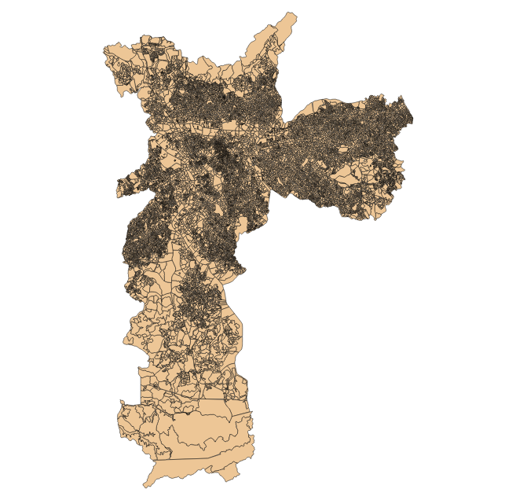

Mounting addresses database

Slide 5
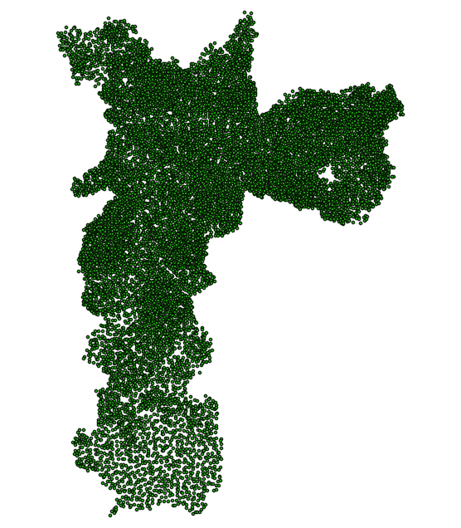
Mounting addresses database

Slide 6
Calculating travel times
Google Scheduler
Google Cloud Computing machine
My code for calculating travel times
Distance Matrix API
Google SQL Database

Slide 7
Google Scheduler
Máquina Virtual do Google Cloud
Programa de Simulação de viagens
API Distance Matrix
Banco de dados
Google SQL

Slide 8
Data Structure
ID | Origin Latitude | Origin Longitude | Destination Latitude | Destination Longitude | Date | Hour | Mode | Distance | Travel time
N = 257,400
128,700 pairs

Slide 9
Preliminary Data Analysis
For the moment – two measures
Diference in Travel Times = Public Travel Time - Private Travel Time
Ratio Travel Times = Public Travel Time/Private Travel Time

Slide 10
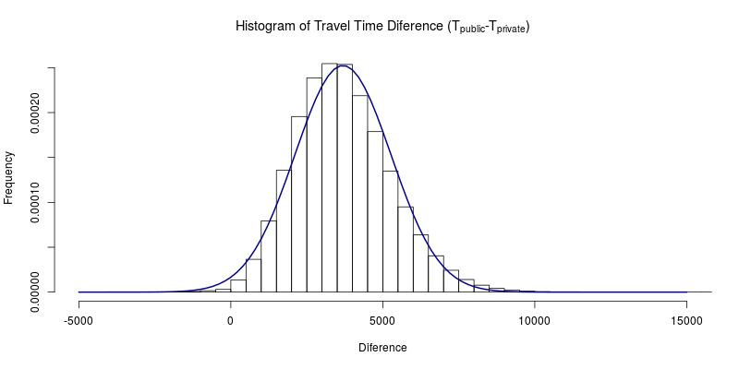
Preliminary Data Analysis
Caracterizing the diference between travel pairs

Slide 11
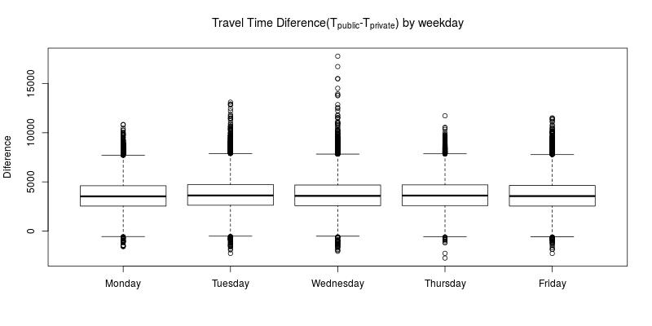
Preliminary Data Analysis
Caracterizing the diference between travel pairs

Slide 12
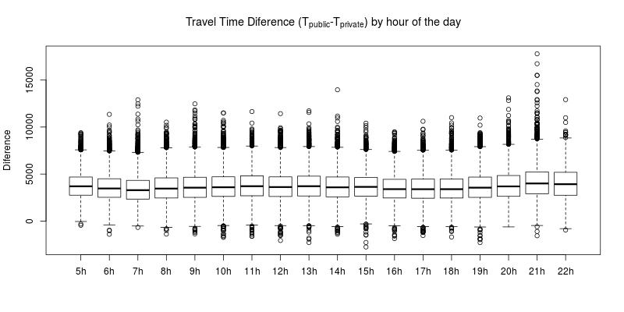
Preliminary Data Analysis
Caracterizing the diference between travel pairs

Slide 13
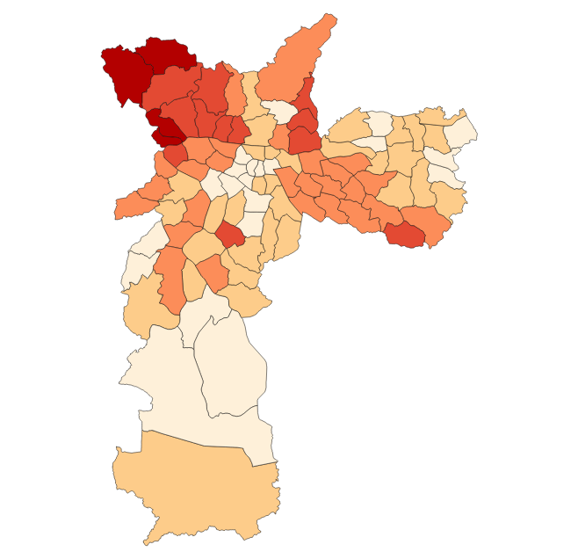
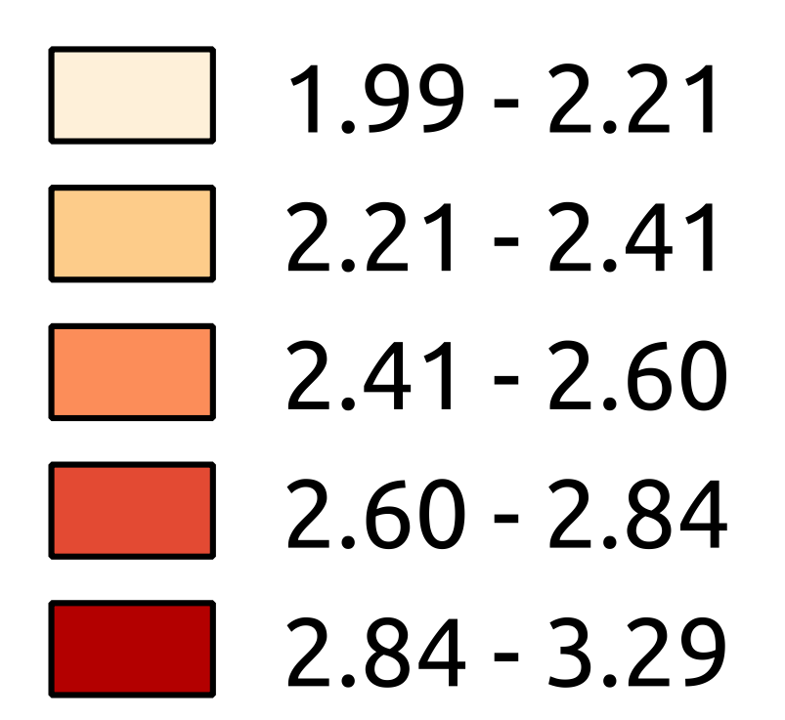
Preliminary Data Analysis
Caracterizing the ratio between travel pairs
(public Travel Time/private Travel Time)
Grouping at district of origin of travel

Slide 14
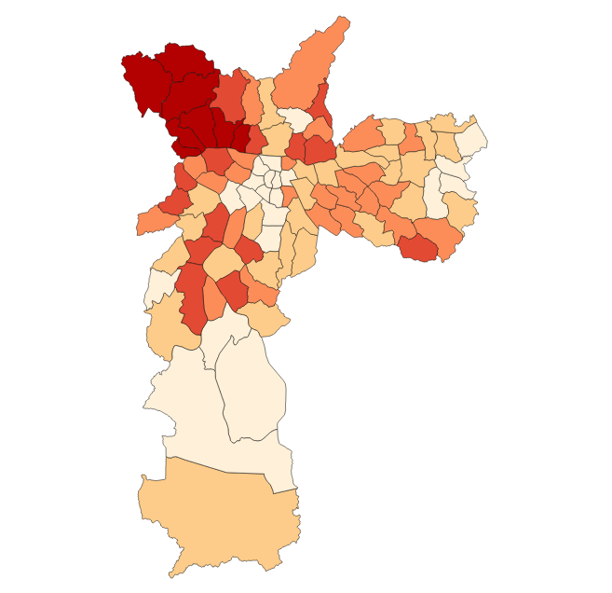
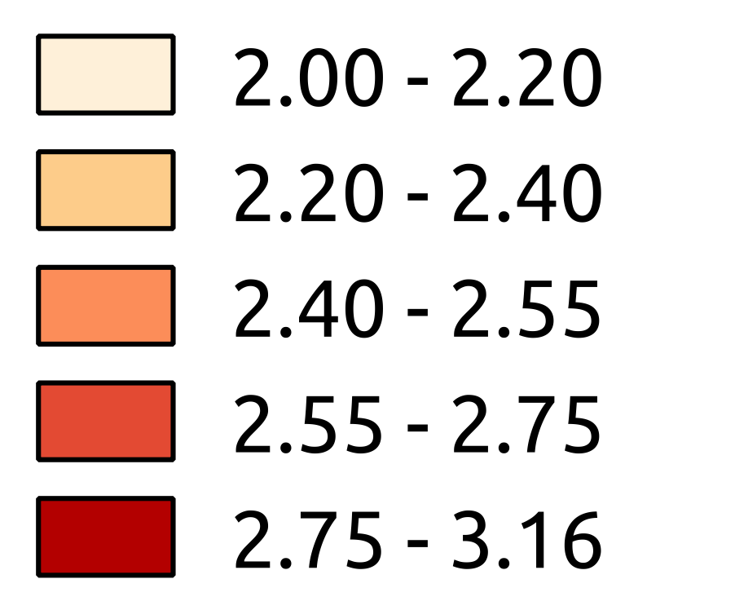
Preliminary Data Analysis
Caracterizing the ratio between travel pairs
(public Travel Time/private Travel Time)
Grouping at district of destination of travel

Slide 15
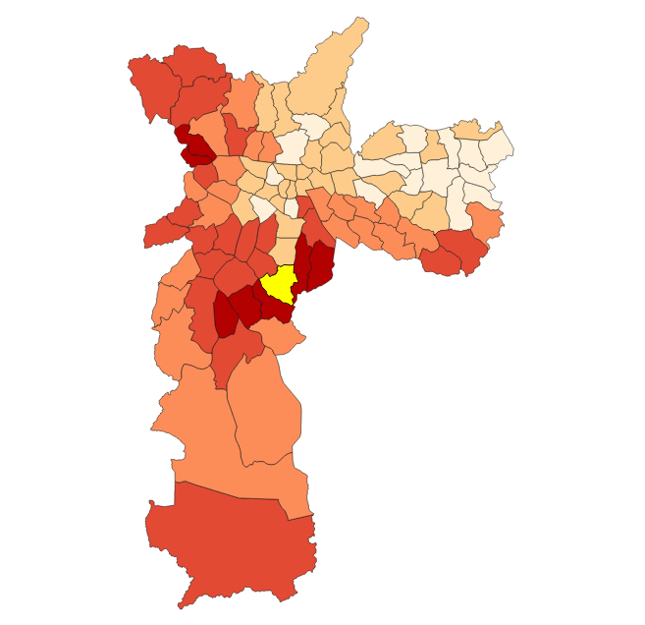
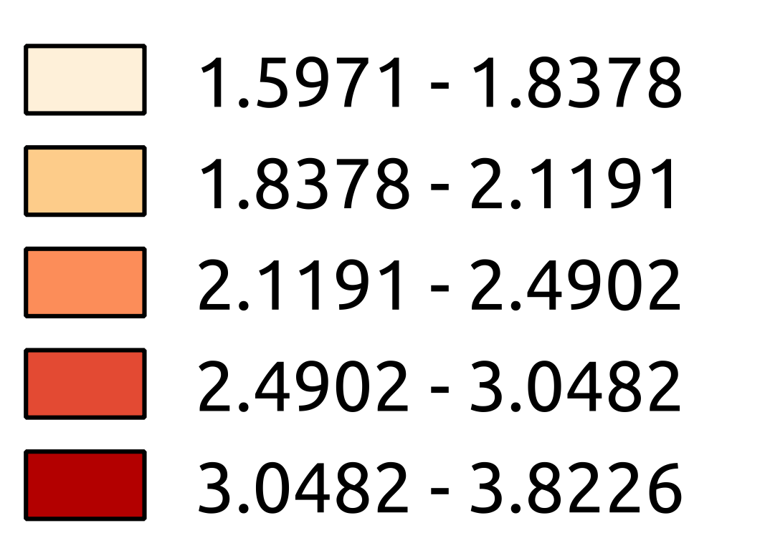
Preliminary Data Analysis
Caracterizing the ratio between travel pairs
(public Travel Time/private Travel Time)
Grouping at district of destination of travel – for travels departing from Jabaquara

